Slide 1
Create a AI driven landscape Generator For Use In Games, Film or Tv Production
Lip Chuan Sui

Slide 2


Agenda
A
Introduction
Primary goals
Areas of growth
Timeline
Summary

Slide 3
Introduction
Using GANS and Houdini to generate tools to use heightmaps in gaming development

Slide 4
Primary goals
Generate hgiehmaps

Slide 5
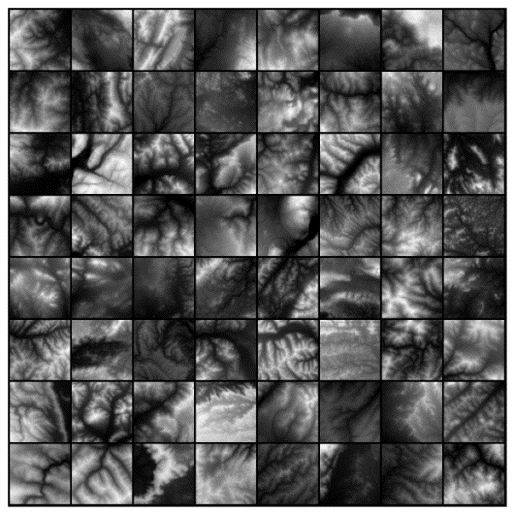
Training data

Slide 6
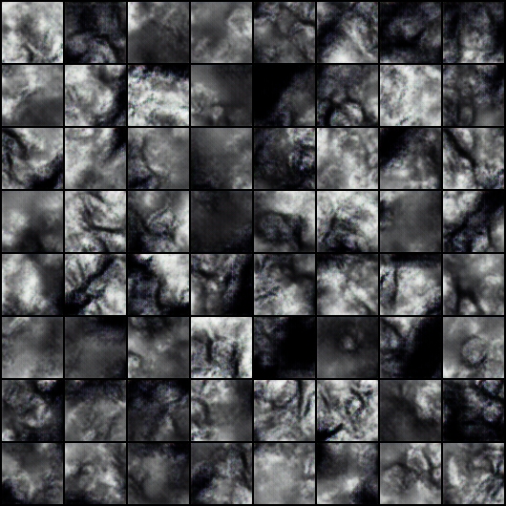
results

Slide 7
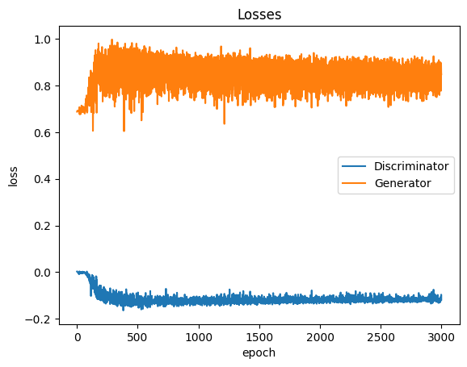
table

Slide 8
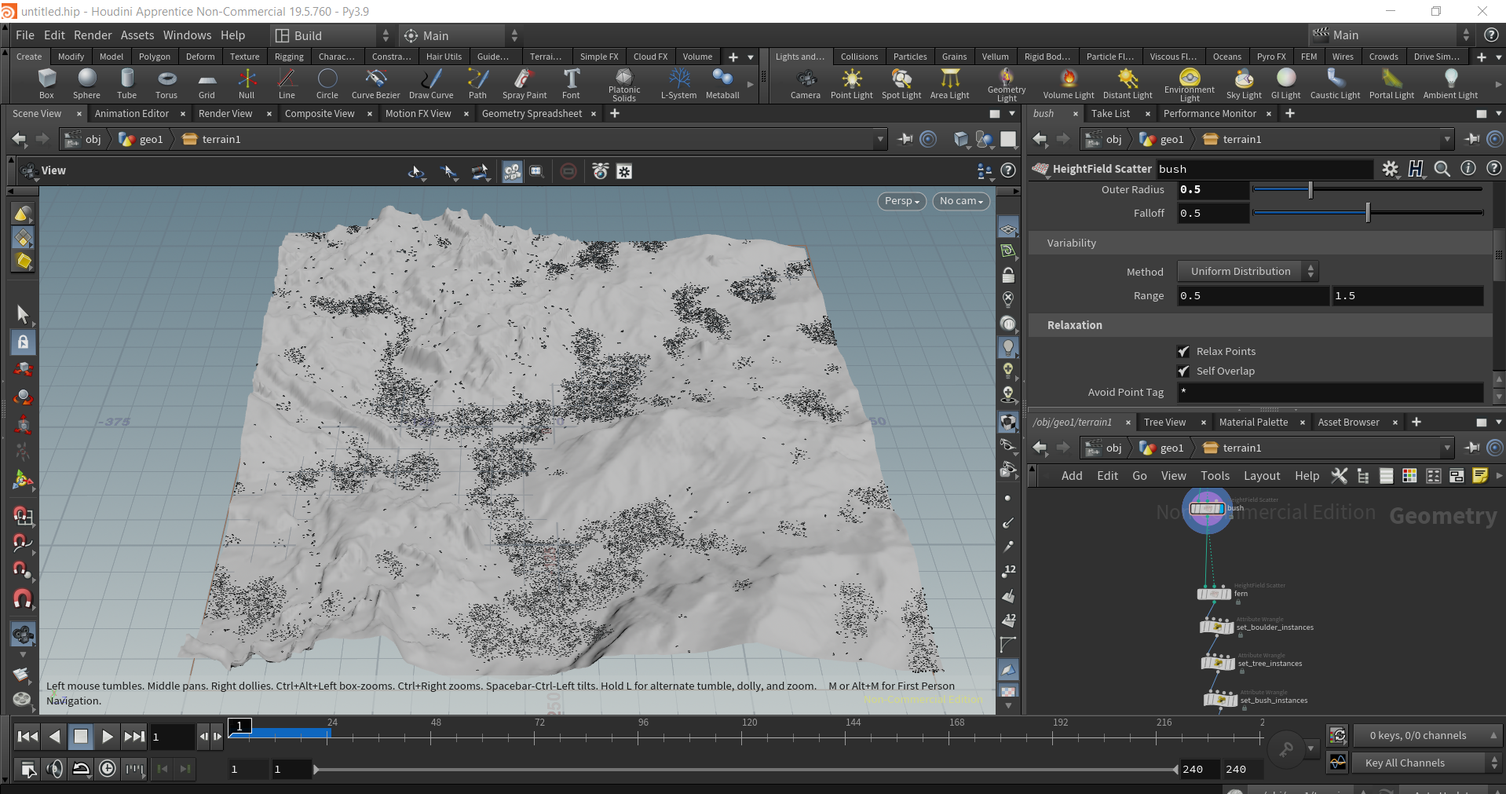
Houdini

Slide 9
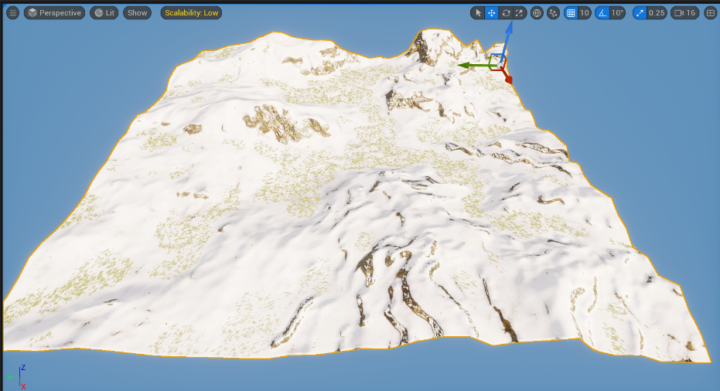
Unreal Engine Snow

Slide 10
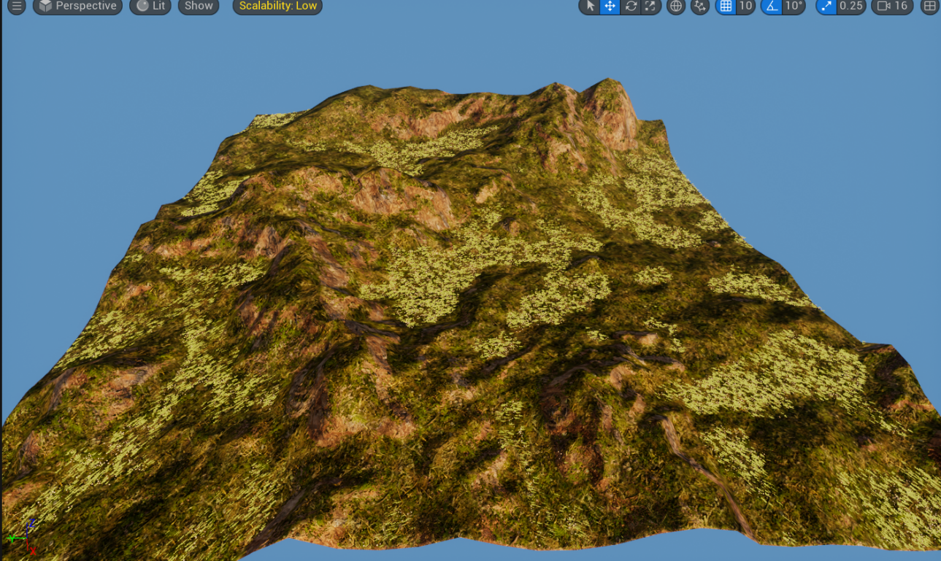
Unreal Engine Mountain

Slide 11
Thank you
Lip Chuan Sui

